Slide 1
final project
File created on: 11/21/2024 8:11:08 PM

Slide 2
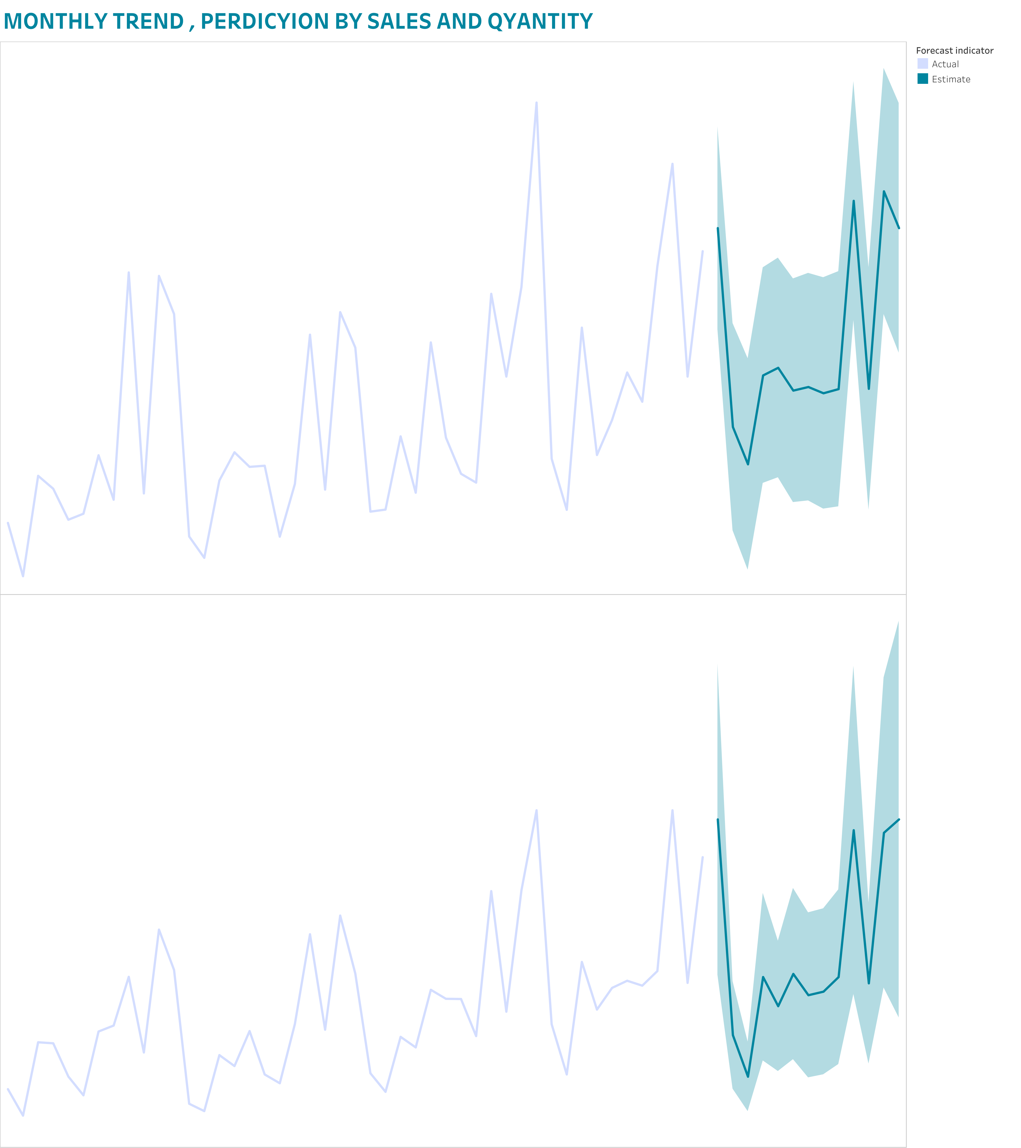

Slide 3


Slide 4
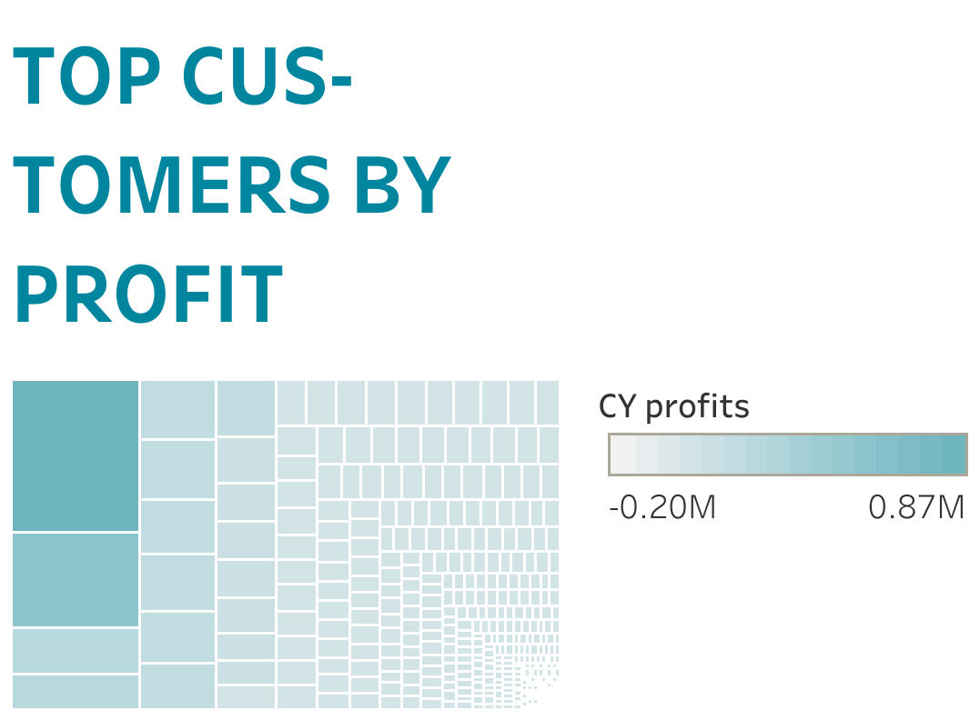

Slide 5


Slide 6


